Slide 1
Chapter 4 – Numpy
2022-2023

Slide 2
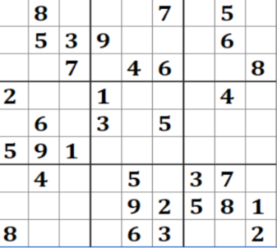

NumPy
Is a very basic yet very powerful way of working with arrays in Python
Remember: Python only uses lists (or tuples or dicts), not arrays
Arrays are of fixed size and contain only 1 datatype
An array can be multidimensional
You come across them very much:
Spreadsheets
Chessboard
Crossword
Sudoku

Slide 3
Jupyter notebook
Creating a NumPy array
Extracting specific items from an array
Computing mean, min, max
Creating a new array from an existing array
Reshaping and Flattening multidimensional arrays
Creating sequences

Slide 4
But why?
When doing ‘normal’ Python programming the difference between a list and a np-array isn’t that big
But when you start doing AI you will feel the difference:
Dijkstra algorithm is a way finding the path through a maze
For this you need to try every single path there is
So you go over the maze a lot
Using a np-array will really start to make a difference there
But NumPy won’t solve everything:
Arrays have one data type: you can’t store age, sex and date of birth together in a np-array
The fix: Pandas dataframes
That are actually combined np-arrays

